Slide 1
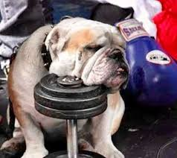
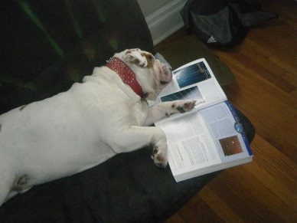
Are you ready?
Raymond B Stewart Middle School presents…
The first annual
Bulldog Boot Camp
Get in shape for 6th grade!
Stewart Middle School will be holding a ‘Boot Camp’ in an effort to help 6th graders in their progression into the middle school environment. Students will be given the opportunity to meet other incoming students, the principal, assistant principals, and teachers. Future Bulldogs will become more familiar with expectations, routines, curriculum, and the layout of the campus. We will even have a scavenger hunt and prizes for the students.
WHEN: Thursday, August 1st
8:30am – 12:00pm (please do not arrive before 8:00am, we will not
have supervision until then)
WHERE: Stewart Middle School
Students sign in at the courtyard at designated tables. We
will dismiss students from the cafeteria at the end of the session.
Please wear comfortable shorts and a t-shirt, as well as comfortable shoes.
Please RSVP by July 15th by filling out the registration form and returning it to the Stewart Middle School’s Front Office c/o Deedra Copeland/ Amy Drury (38505 Tenth Avenue, Zephyrhills, FL 33542).
Students will receive a free Bulldog T-shirt for attending!

Slide 2
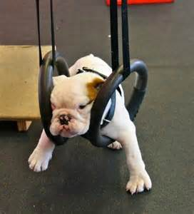
Bulldog Boot Camp Registration Form
Prizes
Fun
Students will learn more about…
Campus life- passing times, the campus layout, Who’s who among staff, receive their schedule, and participate in a scavenger hunt
Tours- Students will be given tours by current Stewart students so they can know where key locations are on campus such as the locker rooms and gym, the 6th grade classrooms, the office area, and the cafeteria (they will be able to practice the lunch line too).
Student responsibilities- They will learn more about MyStudent, academics, time management, ACT time, and the sports we offer.
Expectations-We will review school rules, procedures, dress code, and discipline policy.
Incentives- Explain all of the school wide incentives we offer and even give out prizes
Scavenger Hunt
Please fill out the form below and return it to Stewart Middle School no later than July 15th. Please contact Deedra Copeland or Amy Drury with any questions (dcopelan@pasco.k12.fl.us or adrury@pasco.k12.fl.us ). Looking forward to meeting all our future Bulldogs!
______________________________________________________
Student Name:__________________________________________
Address:_______________________________________________
Home Phone:____________________Work/Cell:______________
Parent Email Address:____________________________________
Elementary School:______________________________________
Allergies/Health Concerns:________________________________
T-Shirt Size: (please circle)
Youth Medium Youth Large Adult Small Adult Medium Adult Large
Parent Name:____________Parent Signature:_________________

